Slide 1
Quantitative Biological Research with Python (92847)
TA 7 – Pandas

Slide 2

Course outline
Weeks 1-3: Basics
Weeks 4-6: Biological sequences
Weeks 7-11: Advanced data processing, visualization & Statistics
Weeks 12-13: Genetic variation, advanced programming skills

Slide 3
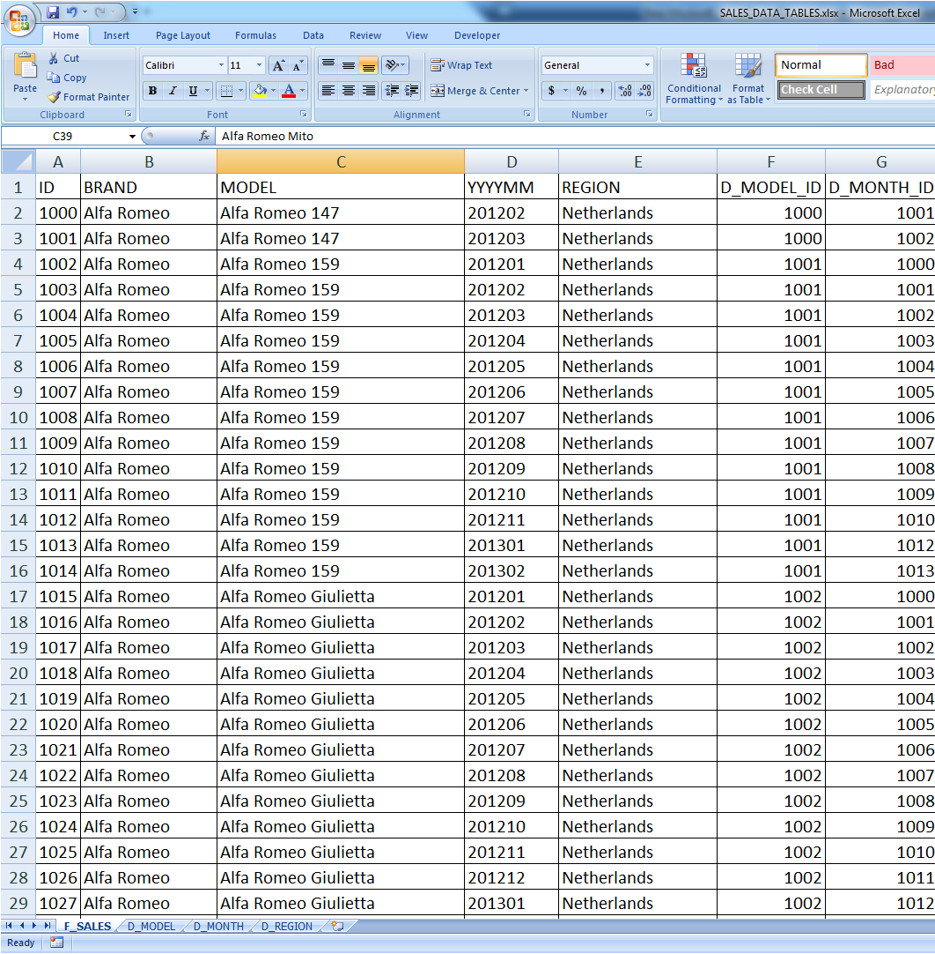
Tabular data
Perhaps the most common data representation
For example, samples (e.g. phenotypes, genotypes, etc.)
A large portion of research work boils down to processing such data
The built-in csv Python library is very limited
  Still requires a lot of parsing work
  Doesn’t provide a nice data structure to work with

Slide 4
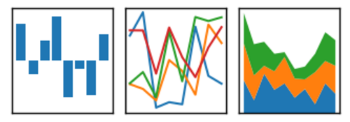
Pandas to the rescue
(Or, how to process tabular data like a pro)
A very strong Python library for processing tabular data
Can handle many formats, including CSV and Excel files
Two main objects: Series and DataFrame
Inspired by R and SQL

Slide 5
Advantages:
  Highly flexible, can do almost any standard processing (e.g. merging, indexing, grouping)
  Efficient (critical code paths written in Cython or C)
  Compatible with Numpy (e.g. dtypes, slicing)
  Good integration with Jupyter and Matplotlib
Pandas is an important element in Python’s ecosystem
  Increasingly, packages are being built on top of it
Great interface, but not always intuitive (great documentation though)

Slide 6
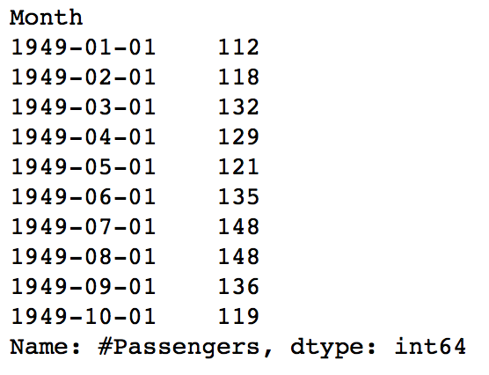
Series
Stores 1D data
A series of (index, value) pairs
Can also be indexed by position
Can be thought of as an ordered dictionary
Index
Value
Name
Type

Slide 7
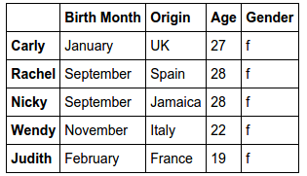
DataFrame
Stores 2D data
Has an index (default is 0…(N-1))
Each column has a type (but can be ‘object’)
Each row and column is a Series
  Row: (column, value)
  Column: (row index, value)
Series and DataFrames are essentially named arrays
Column
Row

Slide 8
pd.read_csv arguments
sep/delimiter (e.g. sep = ‘\t’)
true_values, false_values, na_values
Iterator (for very big files)
There are dozens more, see: http://pandas.pydata.org/pandas-docs/stable/generated/pandas.read_csv.html

Slide 9
Summary
Pandas allows interactive
Often makes Excel redundant
Almost anything can be done efficiently within the framework, without resorting to “pure Python”
  Not always easy to find how
We will learn more advanced stuff later on, e.g.:
  Grouping and aggregation
  Merging DataFrames

